Slide 1
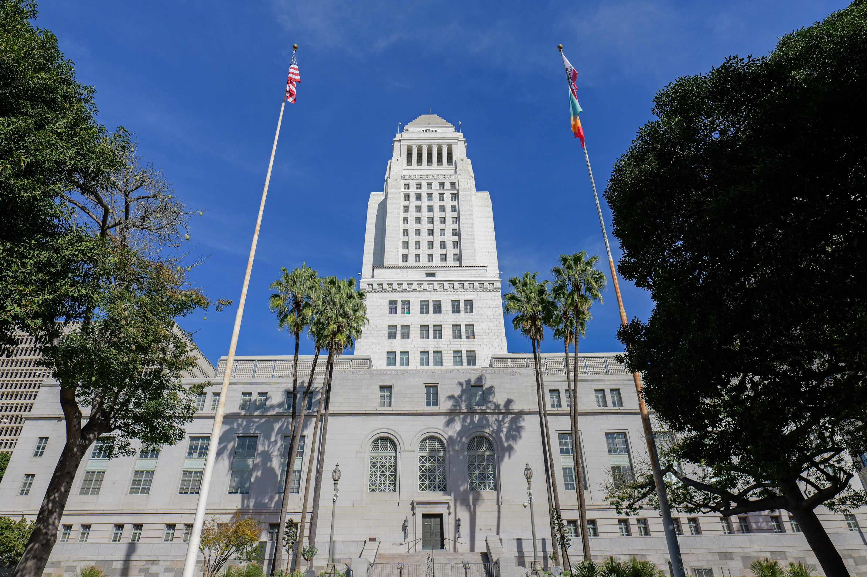

CD8 LEGISLATIVE UPDATES

Slide 2
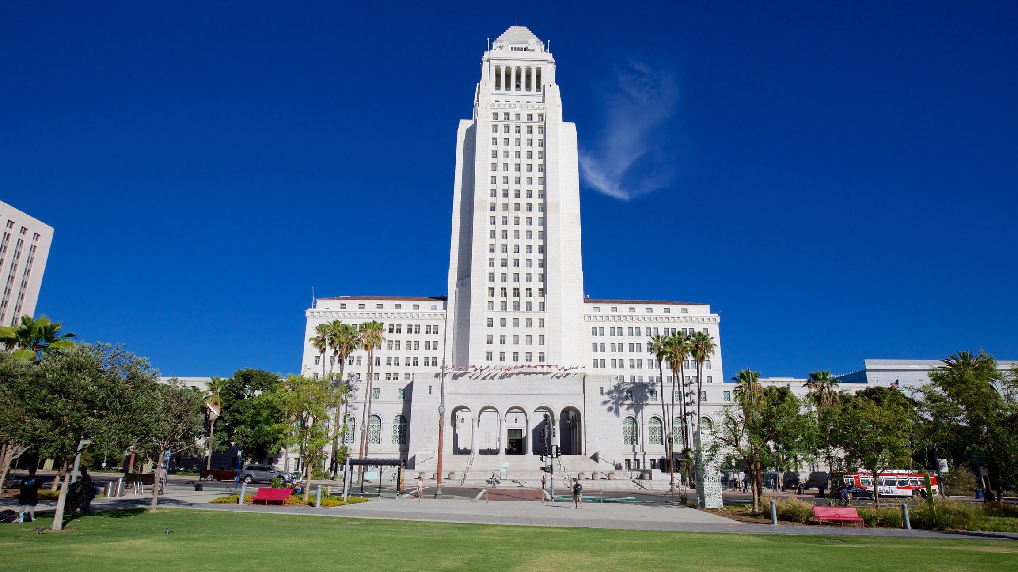
RENT STABILIZATION
ORDINANCE
(RSO)
Notes:
https://revexp.lacontroller.app/

Slide 3
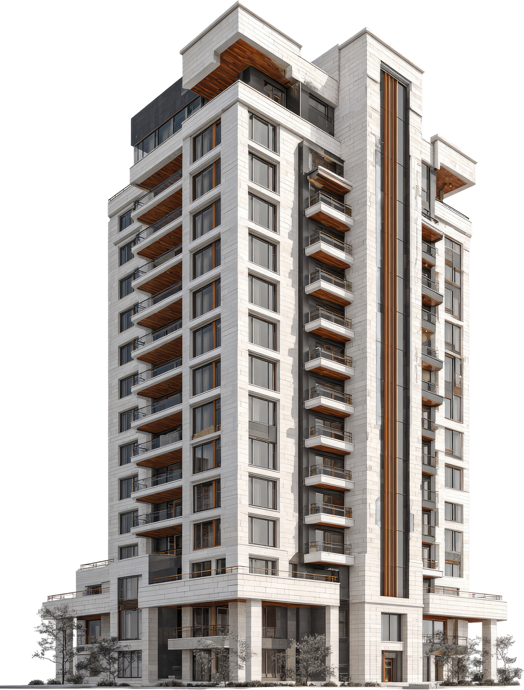
RSO
  Caps rent increases for applicable building
  Provides Required Relocation Assistance for tenants
  Approximately 624,000 units are covered
    7 out 10 renters in the City live in a RSO unit
    Check if you qualify on Zimas.com

Slide 4

ACTIVE CHANGES
  Legislative changes and protections:
    Allowable rent increase
      90% of CPI, but never less than 1% and never more than 4%.
    Can’t make additional increases based on utilities
  Currently, RSO units can only be raised 3% until JUNE 30, 2027
    Recalculation for July 2027

Slide 5
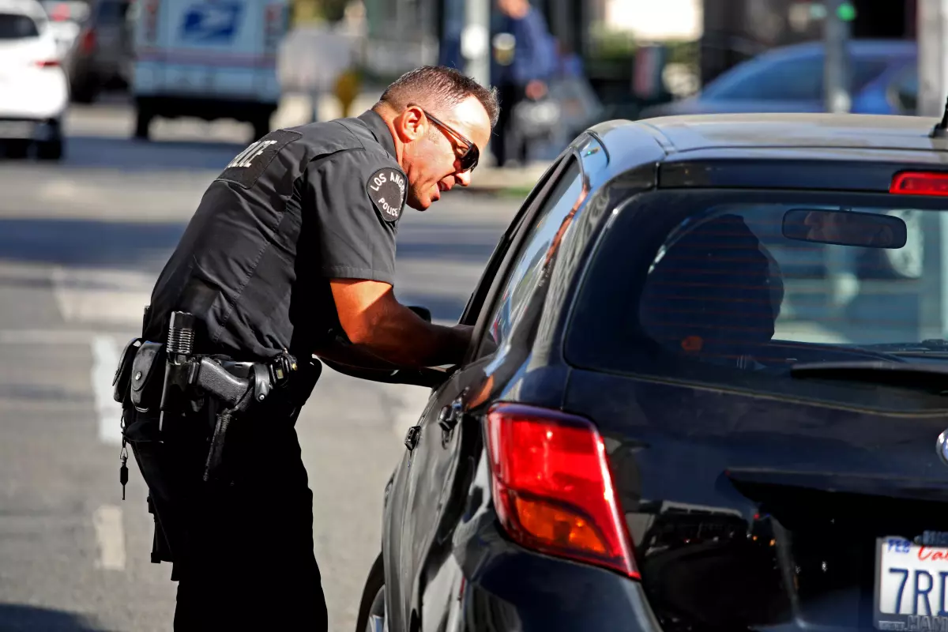
CD8 POLICY PRIORITY:
BANNING PRETEXTUAL STOP

Slide 6

PRETEXTUAL STOPS
  Pre-textual stops are like driving stop and frisks
    when officers use minor traffic violations to look for a more serious crime unrelated to the stop

Slide 7
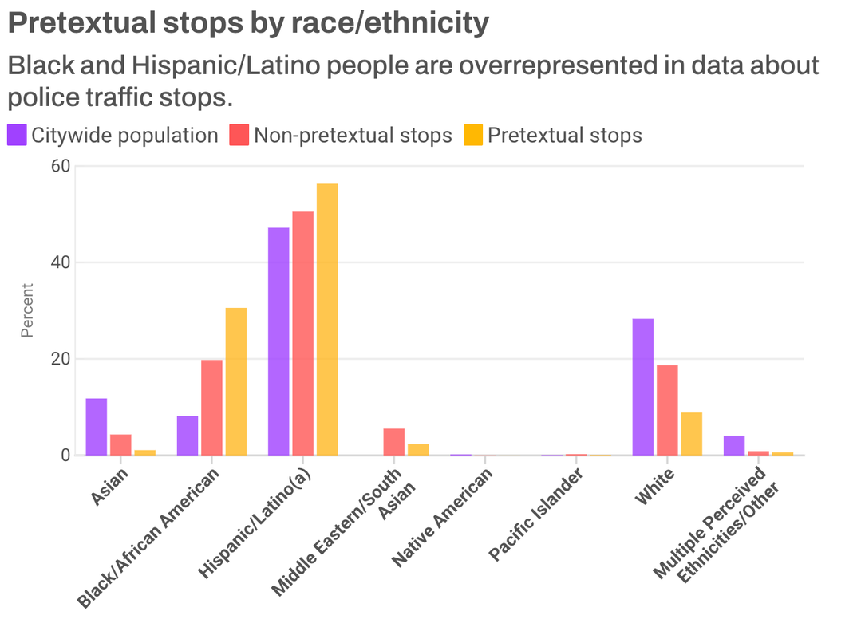
Disparities
  Hispanic/Latino and Black/African American Drivers are far more likely to be pulled over pre-textually
    70.3% of all traffic stops
    86.9% of all pre-textual stops
  In 2025, 67.7% of Pre-textual Stops found nothing
  CD8 has 3rd highest amount of Pre-textual stops in the city

Slide 8

HOW TO GET INVOLVED IN THE CITY BUDGET
FY 26-27
FY BEGINS JULY 1ST AND ENDS JUNE 30
Notes:
https://revexp.lacontroller.app/

Slide 9
BUDGET CYCLE TIMELINE
  November: Departments will submit budgets to Mayor and CAO for FY requests
  March: The Mayor’s office, CAO and CLA will meet with Council Offices and Depts to review budget requests
  April: Mayor presents the proposed budget to City
  April/May: Budget Hearings Departments present their budget requests to B&F cmte.
  May: CLA presents budget modifications to Council
  Late May: Budget is approved by City Council and signed by Mayor
LOS ANGELES CITY budget FY26-27

Slide 10
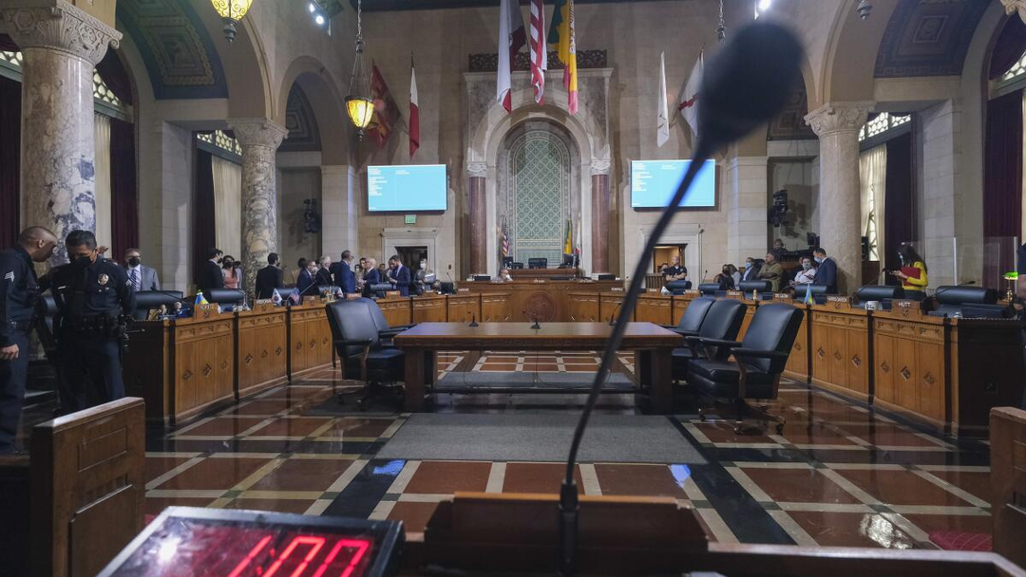
MAKE YOUR VOICE HEARD!
    1st Budget Hearing: April
    Hearings from
Late April - Early May
    Exact Dates TBD
LOS ANGELES CITY budget FY26-27

Slide 11
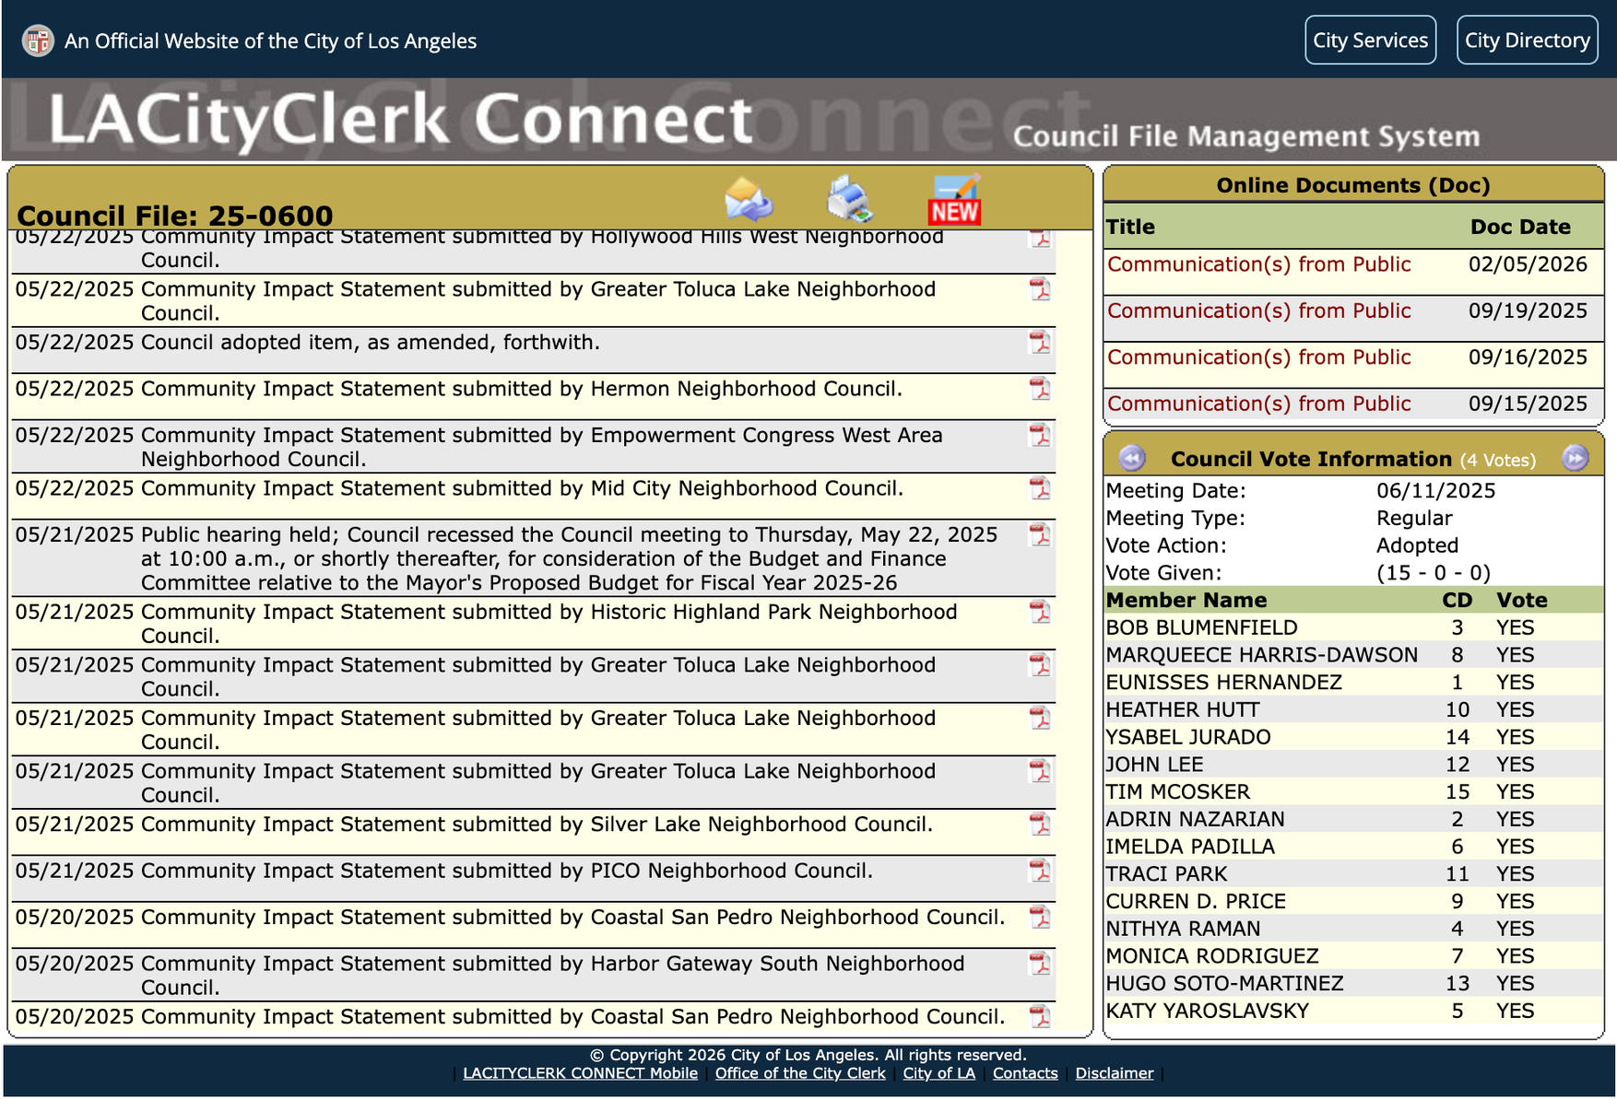
COMMUNITY IMPACT STATEMENTS
  Official Position of the Neighborhood Council on Council Items
  Budget will have its own Council File Number to Track and submit comments to
  Determine if you support or are against certain items in the budget
  Ensure consideration of priorites
LOS ANGELES CITY budget FY26-27

Slide 12
QUESTIONS?
Notes:
https://revexp.lacontroller.app/

